Slide 1
Mechanisms of the Interaction between
Bilingualism and Cognitive Control.
Work conducted at:
Centre of Behavioral and Cognitive Sciences
University of Allahabad
Allahabad
Supervisor: Dr Bhoomika Kar

Slide 2
Cognitive control is the ability to flexibly adapt behaviour to current demands by promoting task-relevant information in the face of interference or competition (Dreher and Berman, 2002).
Bilingualism : we define bilingualism as having some ability to use two or more languages.
Both are Multidimensional construct
Notes:
interference suppression,
inhibiting an inappropriate response,
maintaining the goal of the task in conflicting condition,
switching between task and
Selection between different responses

Slide 3
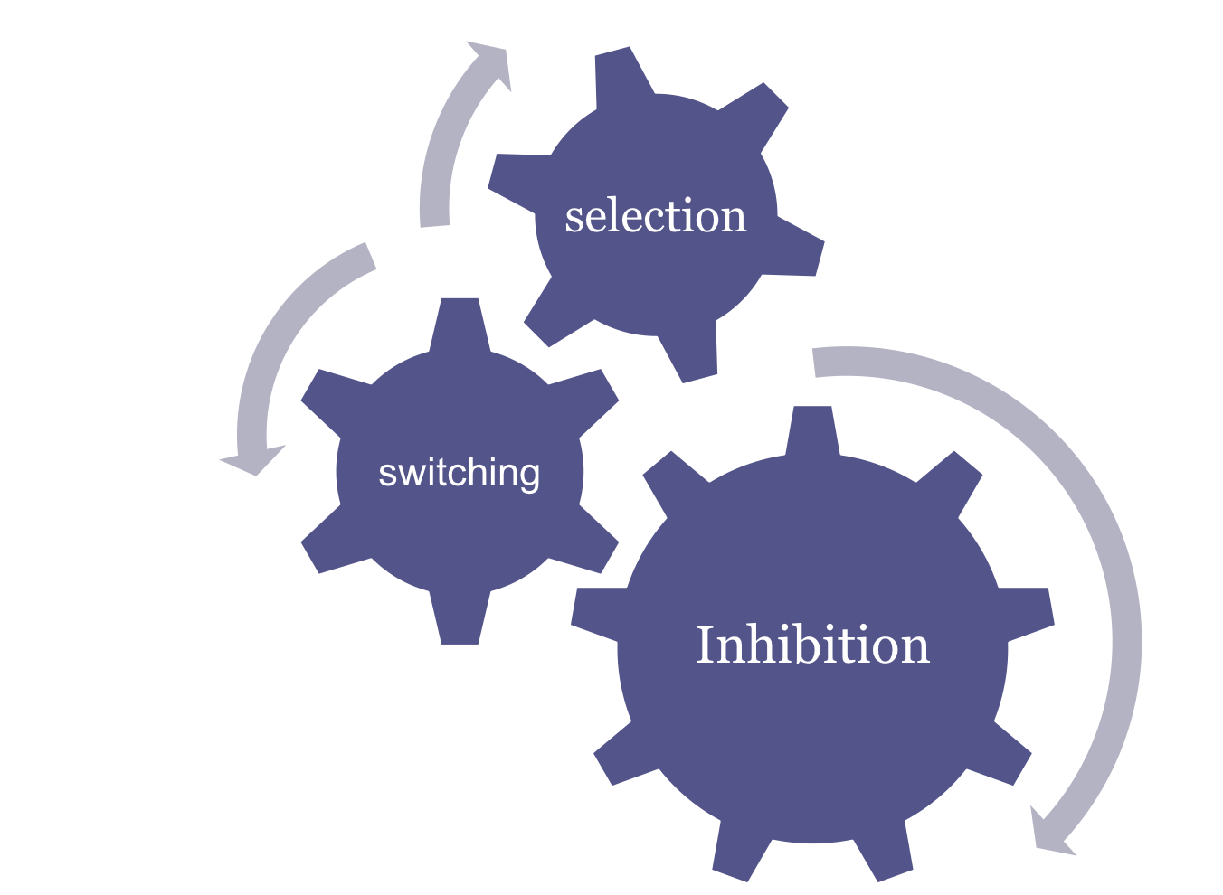
Cognitive control processes enable goal-oriented behaviour

Slide 4
Daily usage of language....
Lexical selection, morphosyntactic organization, discourse production comprehension -simple and automated.
But requires a great deal of planning and sequencing of various elements.
Within a language as well as b/w languages
Some form of system is required to enable the working of these sub components for maximizing performance in a particular language and for minimizing the interference from the other languages.

Slide 5
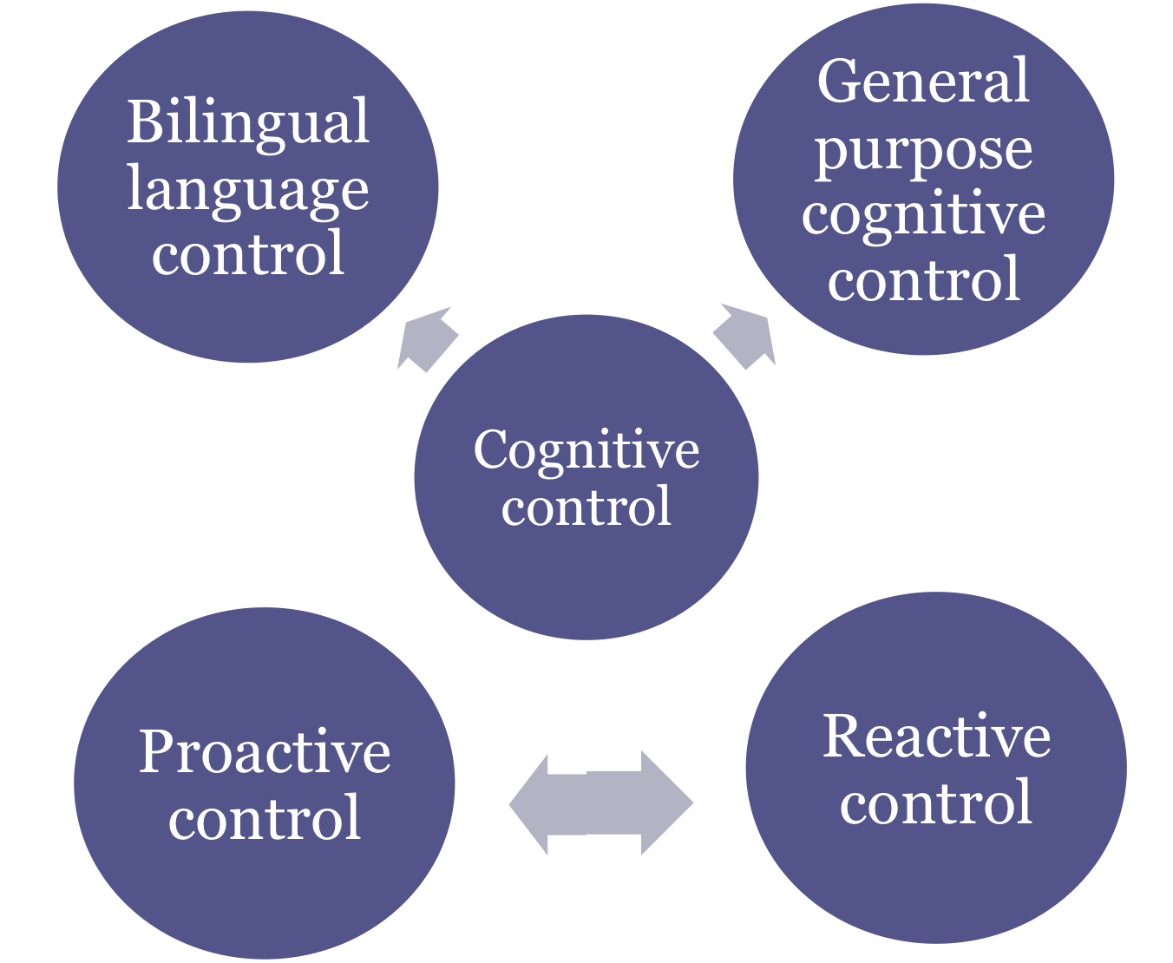

Slide 6
Evidence on bilingualism as a cognitive advantage comes from converging methodologies:
Behavioural studies
(Bialystok et al, 2005, Bialystok, Craik, Klein & Viswanathan, 2004; Martin-Rhee & Bialystok, 2008, Blumenfeld and Marian, 2014)
Event related studies
(Christoffels, Firk and Schiller, 2007; Costa and Santesteban, 2004, Martin et al, 2013)
Neuroimaging techniques
(Rodriguez- Fornell, Balaguer and Munte, 2006, Brian et al 2013)
Case study method
(Green and Abutalebi, 2008; Green et al, 2009; Dash & Kar, 2014)

Slide 7

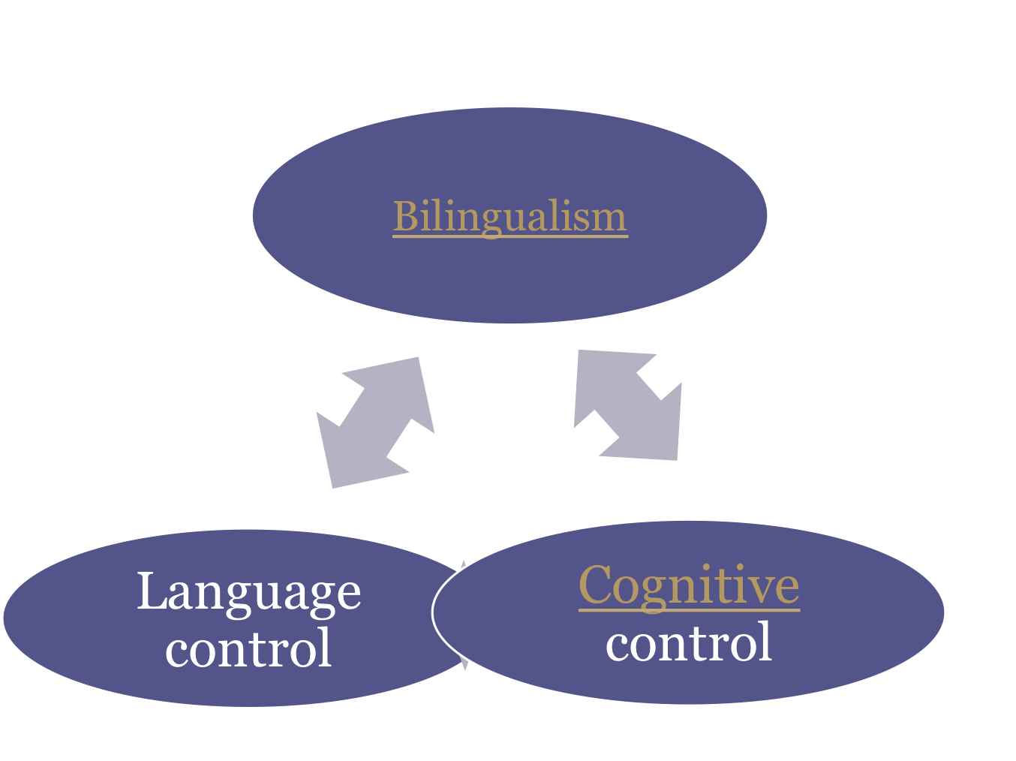


Language use
Language proficiency
Language Acquisition
Notes:
Is this advantage reported in literature is because of just knowing two linguistic systems or factors like proficiency etc influence it in some way………this would be interesting to see.

Slide 8
Objective
To examine whether sub-components of cognitive control (selection and inhibitory control) are affected differently by bilingualism.
Relationship between language proficiency cognitive control.

Slide 9
Outline of the thesis:
Study 1: Bilingualism and language proficiency
  Development of an indigenous test of language proficiency
Study 2: Selective attention in bilingual language processing
    Endogenous cueing paradigm

Slide 10
Study 3: Inhibitory control in bilingual language processing
    Experiment 1: Establishing the Negative priming paradigm with overlapping linguistic stimuli (Behavioural)
    Experiment 2a: Negative priming experiment with linguistic stimuli (ERP)
    Experiment 2b: Negative priming experiment with nonlinguistic stimuli (ERP)
Study 4: Bilingual language control (bLC) and general purpose cognitive control in bilingual aphasia
  4 individual case studies

Slide 11
Study 1: Characterizing language proficiency in Hindi and English language: Implications for bilingual research method

Slide 12
Issues and concern
What aspect of bilingualism is important?
How to test language proficiency?
Language proficiency: categorical or continuous variable?

Slide 13
Screening measures
Language Background Questionnaire
Age of acquisition
Use of languages
frequency of use
self reported proficiency
linguistic environment at home
Test of Language proficiency in Hindi and English
Administered to 85 Hindi-English bilingual adults.
Notes:
acquisition history
contexts of acquisition
environment of acquisition
present language use (in percentage),
language preference
Proficiency rating (0-10 rating scale).
use of language with family, friends, extended family, neighbours +hours of usage (per day).
medium of instruction and
self reported proficiency level on different domains (1-5 point rating). The administration of questionnaire would take approximately 15-20 minutes.

Slide 14
Task/ subtask | Description | Scoring | Number of items
Speaking/understanding domain
Naming | Confrontation naming task | Max S: 30 | 30
Discourse analysis | Picture description task (achievement of the purpose, organization technique and mechanics) Calculation of words per min | Max S: 18 | 1
Auditory comprehension | Auditory discourse comprehension test, participants would be asked questions based on the passage. | Max S:5(Hindi) Max S: 5(English) | 5 5
Convergent production/synonym | For Hindi :synonym task was given (3 synonyms of a particular word.) For English: convergent production task were participants would be asked to name as many meanings possible of a particular word | Max S:9 Max S: 10 | 3 10

Slide 15
Task/ subtask | Description | Scoring | Number of items
Reading/writing domains
Comprehension | Participant would be asked to read a passage, five questions will be asked on the passage. | Max S: 5 | 5
Reading fluency | Reading fluency would be assessed on following subheads: smoothness/pace, confidence, accuracy and expression; which would provide a rubric score of overall fluency | Max S: 16 | 1
Phonological awareness | In this section, subject would be asked to perform tasks involving segmentation, blending, rhyming and counting number of sounds. | Max S: 20 (for Hindi) Max S: 24 (for English) | 20 20
Discourse analysis(written) | In this section, participant would be provided with a topic(procedural description task) and would be required to write on that topic. (achievement of the purpose, organization technique and mechanics) | Max S: 15 | 1

Slide 16
Results:
Normal probability distribution of objective task performance:
  Total scores of speaking understanding domain and reading/writing domain in L1 and L2
Notes:
Provides with a relative position of Z scores

Slide 17
Objective tasks as a measure of language proficiency
discourse analysis
confrontation naming
auditory comprehension
Reading comprehension

Slide 18
Organization of language
(through Factor analysis):
  Within domain:
  Task specific clustering was seen for L1(i.e. naming performances were clustered together, fluency and speed clustered together) in contrast to L2
  Across domain:
  Clustering was seen as production vs comprehension task

Slide 19
Discussion
“Profiling of bilinguals” is critical in bilingual research
Test of language proficiency in Hindi and English can be considered as an objective tool to fulfill this purpose
Organization of language skills is different for L1 and L2- highlights the testing of both the languages
Variability in language proficiency can be explored in a better manner by considering language proficiency as a continuous variable.
Notes:
Language representation Language processing Second language acquisition
Cognitive control Biliteracy
Mechanism of language recovery in disorders

Slide 20
Selective attention and language processing in bilinguals
Study 2
Study 3
Inhibitory control and language processing in bilinguals

Slide 21
Background
In the wide variety of day to day function—attentional processes act to prioritizing the information processing-same hold true for language selection mechanism.
Studies addressing the issue of inhibition in bilinguals (Rodrifues-Fornell et al 2007, Costa et al 2007, Bialystok et al 2004, Singh and Mishra, 2012)
Bilingual language control is not supplementary to general purpose cognitive control (Calabria et al 2012)

Slide 22

Endogenous cueing paradigm

Slide 23
It is used to look at the top-down mechanism of orienting-mediating engaging and disengaging function of attention in the form of valid and invalid cue
Valid cue
Invalid cue

Slide 24
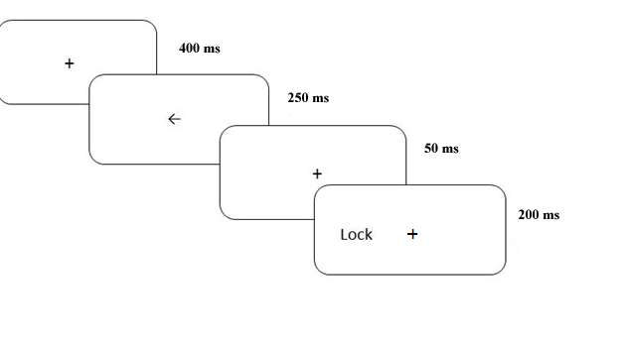
Method
Participants: 29 students from university of Allahabad
Endogenous cueing experiment:
Stimuli: words
Task : animacy judgement task
Separate blocked presentation of L1, L2 and picture stimuli
Proportion: 70% valid, 30% invalid

Slide 25
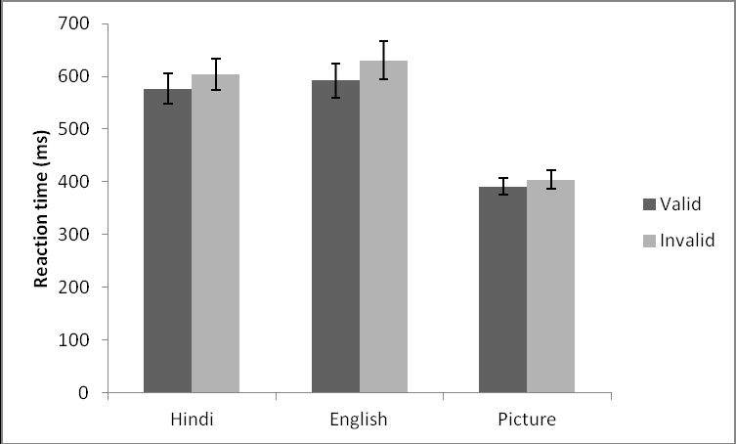
Results
**
Mean reaction times for valid and invalid trials for words in Hindi (L1),
English (L2) and nonlinguistic stimuli
Attention capture is determined by automatic processing in the case of
L1 and picture stimuli. Controlled processing for L2 resulting in larger cueing effect.
Notes:
2 way ANOVA 3 stimulus (L1, L2 and picture) * 2 cue type
Main effect –stimulus type and cue =significant
Interaction –significant
Post hoc showed significant result for only L2

Slide 26
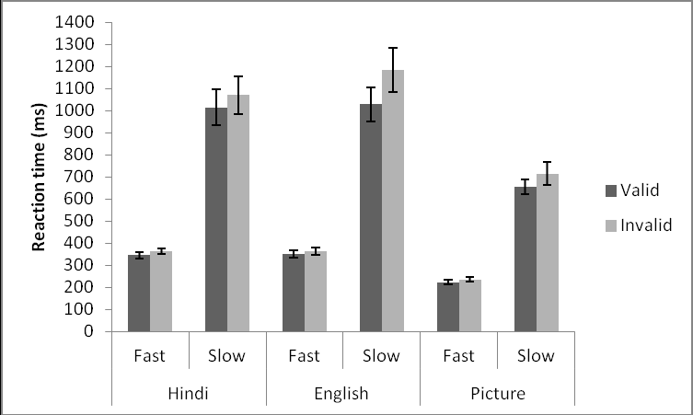
**
**
**
**
Based on slow and fast trials:
    Proactive control for L1 and picture stimuli
    Reactive control for L2 stimuli
Orienting effects and proficiency
  Task specific –L1 and picture stimuli
  Total scores- L2 stimuli
Notes:
3 way ANOVA
3 stimulus*2 cue*2trials
Main effect significant

Slide 27
Discussion
Early selection mechanism involvement for L1/Picture whereas late selection mechanism for L2. L2 is showing cue effect for both slow and fast trial, with larger cue effect for slow trials
Familiarity of letter string/object also influences the mechanism of selection (Givon, 1990)
L1 and L2 language proficiency predicted the performance differently

Slide 28
Negative priming paradigm

Slide 29
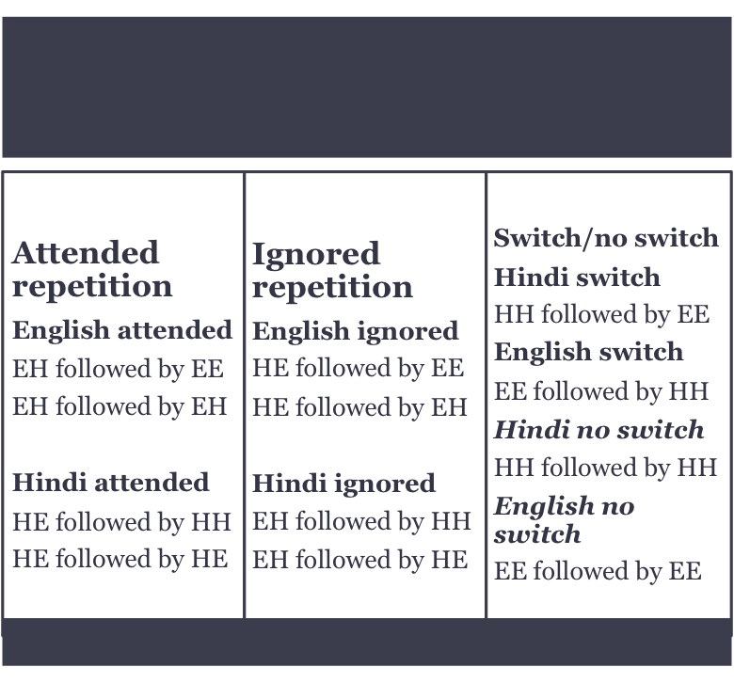
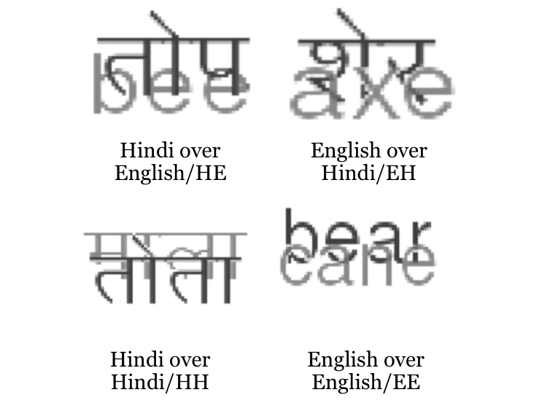
Method:
Participants: 20 Hindi-English Bilingual participants
Stimuli
Notes:
Linguistic and non linguistic stimuli were matched at conceptual level as both consisted of animate and inanimate words/objects

Slide 30
Trial structure
Every stimuli is prime for the next stimulus and probe for the previous one.
+
400 ms
Prime trial
200 ms
+
400 ms
Probe trial
Task: animacy judgment task
Subjects were asked to respond to one
shade of gray
200 ms
Blank screen

Slide 31
Results
Inhibition effects for both the languages for bilingual prime probe combination (L1 p= 0.008 and for L2 p= 0.0021)
Sustained effect of inhibition is greater for L1 as compared to L2
RT analysis for slow and fast trials:
Significant difference at 5th percentile for Hindi (p= 0.022)
Significant difference at 95th percentile for English (p=0.002)

Slide 32
Experiment 2a
ERP recordings were done by using 64 electrode neuroscan system, preliminary result suggests of larger N200 amplitude for Hindi as compared to English on FCZ site.

Slide 33
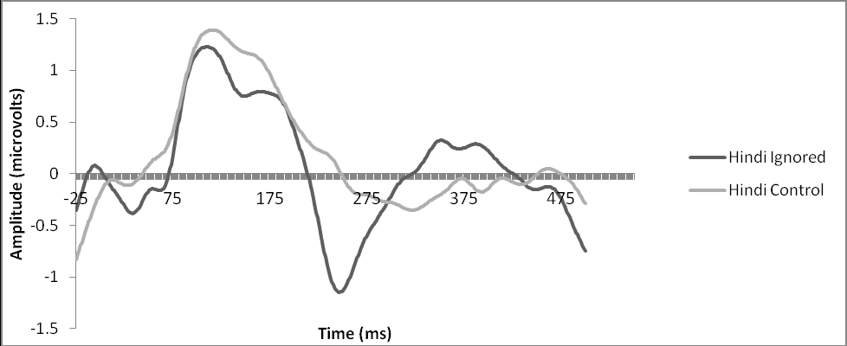
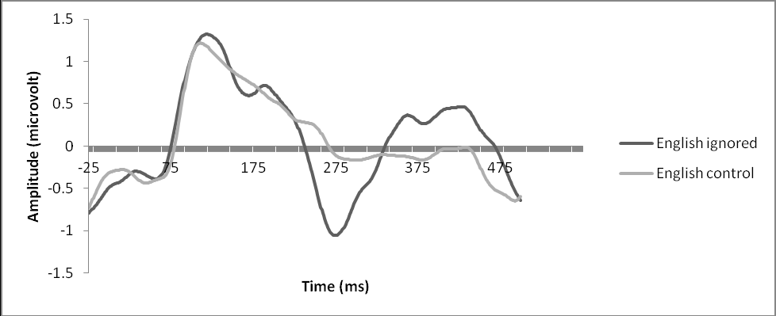
L1 (Hindi): mean peak latency 237 ms, mean peak amplitude differences were significant , p=0.015
L2 (English): mean peak latency 267 ms, mean peak amplitude differences were significant , p=0.003

Slide 34
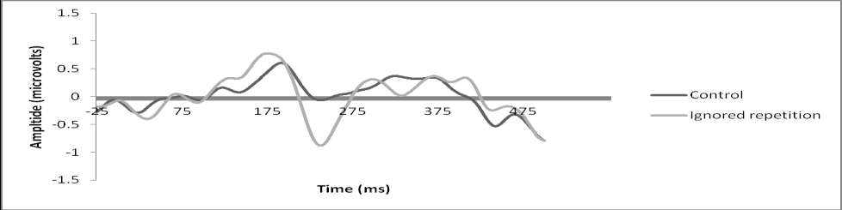
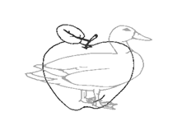
Experiment 2b: Non linguistic identity negative priming
Inhibitory effect present for non linguistic version, p=0.013
Stimulus used for the nonlingusitic experiment

Slide 35
Inhibitory control as a function of language proficiency
Behavioural as well as linguistic negative priming experiment showed task specific L1 proficiency prediction for L1 inhibition effect, whereas total score of L2 proficiency predicts L2 inhibition effect.
In nonlinguistic negative priming experiment overall L1 proficiency was able to predict the performance, where as there was task specific prediction for L2.
Key objective tasks which were able to predict performance in all the experiments: discourse analysis, synonym task, reading comprehension, reading speed

Slide 36
Discussion:
Behavioural data showed inhibition effects in both the languages as a function of weight of language in probe trial
Language specific differences in both proactive and reactive mechanism of control
bLC and general purpose cognitive control
Commonality | Differences
Presence of N200 in both linguistic and nonlinguistic experiment | Latency differences Picture<L1<L2
Similar morphology of the waveform | Amplitude differences Picture>L1>L2
Language proficiency predicted the performance | L1 proficiency=task specific L2 proficiency= total scores

Slide 37
Study 4: Bilingual aphasia and cognitive control

Slide 38
Background
Evidence suggest that communicative success in aphasia depends on integrity of executive functions (Purdy, 2002).
Bilingual aphasic shows faster rate of recovery compared to monolingual (Penn et al 2010)
bilingual aphasic having problem in control without having problem related to language interference. (Abutalebi and Green , 2007)

Slide 39
Method
Participants: 4 bilingual individuals with aphasia
Language background questionnaire (Vasanta et al 2010)
Picture description task
Western Aphasia Battery (Kertesz, 1979)
Aphasia severity rating (Goodglass and Kaplan, 1994)
3 Experiments:
    Nonlinguistic negative priming task
    Linguistic flanker task
    Nonlinguistic flanker task

Slide 40
Participants | CR | MMH | SC | MU
Age | 33 years | 34 years | 35 years | 59 years
Etiology | Bacterial meningitis | CVA | Trauma | CVA
Time post stroke | 17 months | 26 months | 15months | 20 months
Native language | Telugu | Hindi/Urdu | Telugu | Hindi
Educational and work background | MBA and currently employed as a banker | Postgraduate and currently unemployed | B.Tech and own a construction business | Retired as assistant controller of examination for an university
Languages known (in order of dominance) | Telugu, English, Hindi | Hindi, English, Urdu | Telugu, English, Tamil, Hindi | Hindi, English, Urdu
Aphasia type | Anomic aphasia | Anomic aphasia | Broca's aphasia | Anomic aphasia
Rehabilitation period | 15 months | 20 months | 3 months | 17months
Aphasia severity | 2 | 3 | 1 | 3
Language for therapy | L2 | Both L1 and L2 | Both L1 and L2, more emphasis L1. | L1

Slide 41
Trial structure
Negative priming task
+
400 ms
300 ms
Prime trial
500 ms
Probe trial
500 ms
Followed by a blank screen for
Response: until response or
maximum of 3000ms

Slide 42
Flanker task
To study the cognitive processes involved in detection and recognition of targets in the presence of distracting information or noise (Eriksen &Eriksen, 1974)
Stimuli: array of arrows/array of letters
Task: participants were asked to judge the identity of the central arrow/letter by pressing a desired key

Slide 43



Trial structure
Nonlinguistic flanker task
Congruent
>>>>>
<<<<<
Incongruent
<<><<
>><>>
Neutral
--<--
-->--
+
400 ms
<<<<<
500 ms
+
Until response/3000 ms

Slide 44
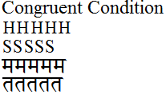

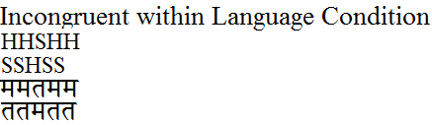
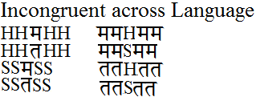
Trial structure
Linguistic flanker task
+
400 ms
HHSHH
500 ms
+
Until response/3000 ms

Slide 45
Result: negative priming
Presence of facilitation effects in all 4 participants
Absence of inhibition effects
CDF analysis showed the presence of inhibition effect only on slow trials for CR, SC and MU. Slide 71
Performance of all the participants on the negative priming task primarily reflected the involvement of reactive control mechanisms.

Slide 46
Result: nonlinguistic flanker task
Congruency effect was evident on the non linguistic flanker task for all the participants with respect to the mean reaction times.
This congruency effect was only present for the slow trial and absent for fast trial
Result: linguistic flanker task
Showed reactive control for the flanker task in both within language and across language congruency effect

Slide 47
Relationship between performance and language proficiency/language background information
Language use-no significant correlation seen
Inhibition effects in non linguistic tasks are better correlated with L1 proficiency
Linguistic flanker effects in L1 and L2 better correlated with L2 proficiency

Slide 48
Discussion
Inhibitory control underlying selective attention may be impaired in the participants with anterior aphasia, the ability to differentiate target from distractor may be preserved hence the presence of flanker effects on the flanker task.
bLC and general purpose cognitive control:
All four participants showed dependence on the reactive control mechanisms.
Commonalities | Differences
Presence of flanker effect in linguistic and nonlinguistic stimuli | -Absence of non linguistic inhibition effect -It was interesting to note that the variations in the performance of each participant surfaced to a greater degree in case of linguistic stimuli for bothL1 and L2.
Language proficiency, % exposure as well language of therapy can account for the difference | L1 language proficiency-predicts performance of nonlinguistic task L2 language proficiency-Linguistic tasks

Slide 49
General discussion and conclusion

Slide 50
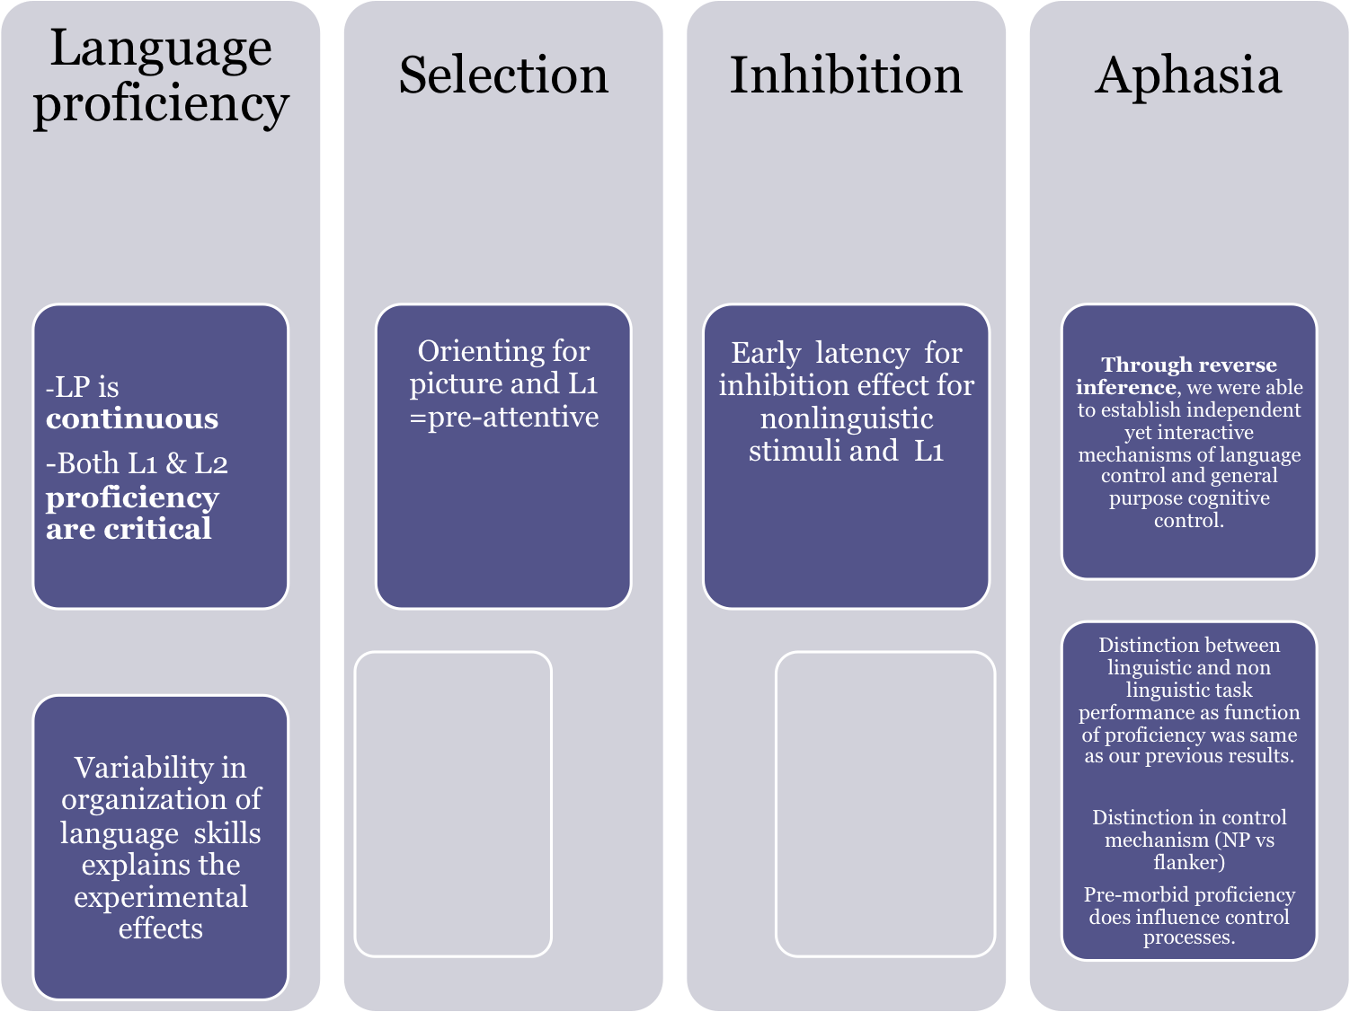

Comparison between linguistic and non linguistic stimuli
To establish bLC and GPCC relationship
Methodological advantage
Does suggest a trend between both the sub component in a serial manner
Use of comprehensive tool
Similar LP
prediction
LP doesn't vary based on sub component of control
LP varies based on STIMULUS type

Slide 51
Bilingualism?
Language organization (L1 and L2) has influence on performance of cognitive control tasks.
This gives us stronger evidence regarding the interaction of bilingualism and cognitive control.
Component processes of cognitive control can be differently influenced by bilingualism.
What aspect of bilingualism?
  ANSWER: Language proficiency
What aspect of language proficiency?
  ANSWER: How language proficiency is achieved and how linguistic skills are organized.
Notes:
L1 proficiency

Slide 52
Bilingualism & Cognitive control
bLC is not subsidiary to GPCC; Independent yet interactive mechanisms
proactive and reactive control mechanisms are probably not mutually exclusive but rather interact for the efficient execution of cognitive control.
Variation in stimuli and language proficiency influences this interaction.

Slide 53
List of publications:
Paper(s)
  Dash, T. & Kar, B. R. (2012). Characterizing language proficiency in Hindi and English language: Implications for bilingual research. International Journal of Mind Brain and Cognition, 3(1): 73-105.
  Dash, T. & Kar, B. R. Bilingual language control and general purpose cognitive control among individuals with bilingual aphasia: Evidence based on negative priming and flanker tasks (accepted in Behavioural Neurology)
Paper (in revision)
  Behavioural and ERP correlates of bilingual language control and general purpose inhibitory control predicted by L1 and L2 proficiency: evidence based on the identity negative priming paradigm.
  Behavioural correlates of voluntary orienting predicted by L1 and L2 proficiency: evidence based on cueing paradigm
Book chapter
  Kar, B. R., Khare, V. & Dash, T. (2011). Bilingualism and Cognitive Control: Is bilingualism a Cognitive Advantage? In R. K. Mishra & N. Srinivasan, Language and Cognition: State of the Art. Munich: Lincom Europa.

Slide 54
Conference presentation
DASH, T., AND KAR, B.R. “Language proficiency in bilingual individuals: self reported information versus objective measures of language skills” at the Annual Meeting of the National Academy of Psychology, 2010
DASH, T., AND KAR, B.R. “Selective attention and language processing in bilinguals” at the International Conference on Cognitive development, 2010
DASH, T., AND KAR, B.R. “Inhibitory control in Bilingual language processing” at the Annual Meeting of the National Academy of Psychology, 2011
DASH, T., AND KAR, B.R. “Inhibitory control mechanism in Bilingual language processing-ERP Study” at the World Congress of Neuroscience, 2011 (received best poster award)
DASH, T., AND KAR, B.R. “Bilingual language control and general purpose cognitive control in relation to bilingual language proficiency: Evidence from negative priming paradigm” at the Japanese Neuroscience Society annual meeting. July 2012.
DASH, T; AND KAR, B, R. "Cognitive and neural mechanisms of the interaction between bilingualism and cognitive control" at World Federation of Neurology, Aphasia and related cognitive disorder conference in Hyderabad on December 9-12, 2012.

Slide 55
Awards and Grants
Junior Research fellowship from Department of Science and Technology, INDIA for the project “Multilingualism and Cognitive Control”
Fellowship from International Brain Research Organization to attend “IBRO-APRC School of Neuroscience” held in National Brain Research Centre during 29/11/2010 till 12/10/2010.
Fellowship from International Brain Research Organization to attend “Young Investigator training program” for which training was organized in INSERM, Tours, France for a period of 1 month from 12/06/2011 till 12/06/2011.
Young Investigator Travel award by the Japanese Neuroscience Society for attending and presenting my poster in the 35th annual meeting of JNS.
Participated as a rapporteur in a symposium titled "Language, Literacy and cognitive development: the interface" organized by The Promise foundation, Bangalore in December 2011.

Slide 56

Thank you…

Slide 57
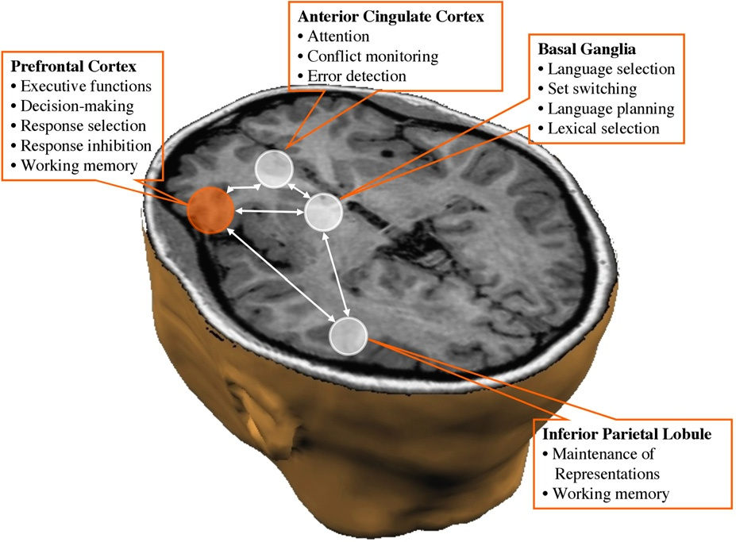

Slide 58
Participants | CR | MMH | SC | MU
Languages exposed at home | Telugu (sometimes Kannada) | Urdu/Hindi | Telugu (sometimes Tamil with extended family) | Hindi/Urdu
Languages exposed at office/workplace/college | English, Kannada, Hindi | English, Hindi, Kannada | English, Telugu, Hindi | English, Hindi
Age of acquisition: | L1 (Telugu): Since birth L2 (English): 10th standard L3 (Kannada): after arriving at Kannada speaking state due to occupational needs in 2008 | L1 (Hindi/Urdu): Since birth L2 (English): 3.5 years L3 (Kannada): after arriving at Kannada speaking state (10 years) | L1 (Telugu): Since birth L2 (Tamil): exposed since birth L3 (English): since school i.e. 1st standard | L1 (Hindi/Urdu): Since birth L2 (English): since school i.e. 1st standard
Order of dominance (premorbid):
L1 | Telugu (60%) | Hindi/Urdu (70%) | Telugu (50%) | Hindi (50%)
L2 | English (40%) | English (30%) | English (50%) | English (50%)
Order of dominance (postmorbid):
L1 | Telugu (30%) | Hindi/Urdu (85%) | Telugu (60%) | Hindi (90%)
L2 | English (70%) | English (15%) | English (40%) | English (10%)
 | Sporadic usage of Kannada and Hindi | Sporadic usage of Kannada | Sporadic usage of Tamil and Hindi
Modality of language acquisition:
L1 | both (oral/written and formal/informal) | both (oral/written and formal/informal) | both (oral/written and formal/informal) | both (oral/written and formal/informal)
L2 | both (oral/written and formal/informal) | both (oral/written and formal/informal) | both (oral/written and formal/informal) | both (oral/written and formal/informal)

Slide 59
Participants | CR | MMH | SC | MU
Family members uses following languages:
Grandparents, parents, siblings- | Telugu | Hindi/Urdu | Telugu/Tamil | Hindi
Neighbours/children - | Kannada | Kannada | Hindi/Telugu | Hindi
Language use choice: 3 point rating (Composite scores) | (can perform 3/10 tasks) | (can perform 6/10 tasks) | (can perform 6/10 tasks) | (can perform 5/10 tasks)
L1 | 3 | 1 | 1 | 2.7
L2 | 2 | 2.7 | 3 | 2
Language proficiency 5 point rating (Composite scores) | (can perform 5/15 tasks) | (can perform 7/15 tasks) | (can perform 6/15 tasks) | (can perform 10/15 tasks)
L1 | 2.25 | 2.53 | 3.1 | 4.25
L2 | 4.25 | 3.25 | 2.83 | 2.25
Self reported proficiency (5point rating)
Reading (L1 L2) | 4 4 | 4 4 | 2 2 | 2 3
Writing (L1 L2) | 3 4 | 3 4 | 1 2 | 2 2
Speaking (L1 L2) | 3 4 | 3 4 | 2 2 | 3 2
Understanding (L1 L2) | 4 4 | 4 4 | 4 3 | 4 4

Slide 60
Participants | CR | MMH | SC | MU
Age | 33 years | 34 years | 35 years | 59 years
Etiology | Bacterial meningitis | CVA | Trauma | CVA
Time post stroke | 17 months | 26 months | 15months | 20 months
Native language | Telugu | Hindi/Urdu | Telugu | Hindi
Educational and work background | MBA and currently employed as a banker | Postgraduate and currently unemployed | B.Tech and own a construction business | Retired as assistant controller of examination for an university
Languages known (in order of dominance) | Telugu, English, Hindi | Hindi, English, Urdu | Telugu, English, Tamil, Hindi | Hindi, English, Urdu
Aphasia type | Anomic aphasia | Anomic aphasia | Broca's aphasia | Anomic aphasia
Rehabilitation period | 15 months | 20 months | 3 months | 17months
Aphasia severity | 2 | 3 | 1 | 3
Language for therapy | L2 | Both L1 and L2 | Both L1 and L2, more emphasis L1. | L1

Slide 61
Participants WAB task (Maximum scores) | CR | MMH | SC | MU
Spontaneous speech Information content (10) Fluency (10) | 7 4 | 9 9 | 4 5 | 8 9
Auditory verbal comprehension Yes/no question (60) Auditory word recognition (60) Sequential commands (80) | 48 60 40 | 60 58 72 | 20 53 21 | 58 48 74
Repetition (100) | 45 | 81 | 26 | 79
Naming Object naming (60) Word fluency (20) Sentence completion (10) Responsive speech (10) | 40 3 4 3 | 59 12 7 10 | 4 2 2 5 | 45 15 8 9

Slide 62
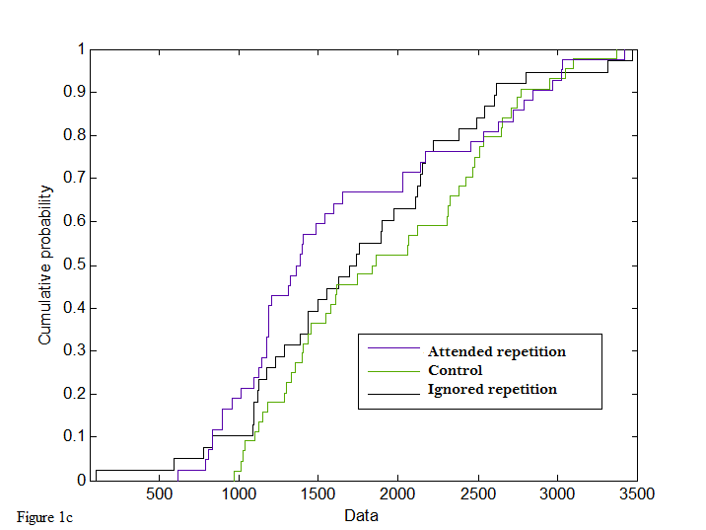
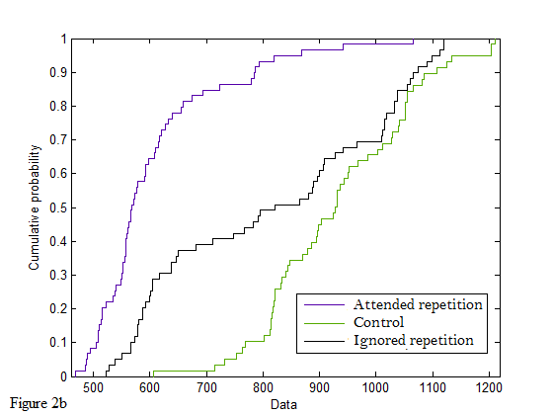
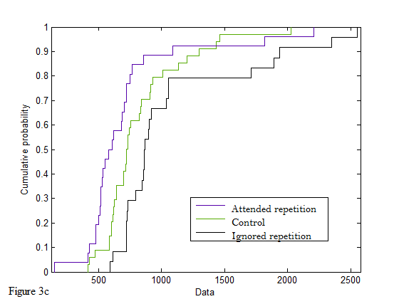
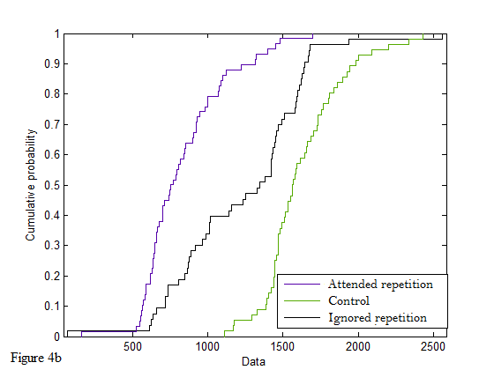

Slide 63
